Slide 1
SharePoint Framework M9
Jenkins NS
@jenkinsns

Slide 2

Agenda
Module 9: Deploying SharePoint Artifacts
Deploying SharePoint Artifacts to app catalog
Deployment Options
Asset Types
Features

Slide 3
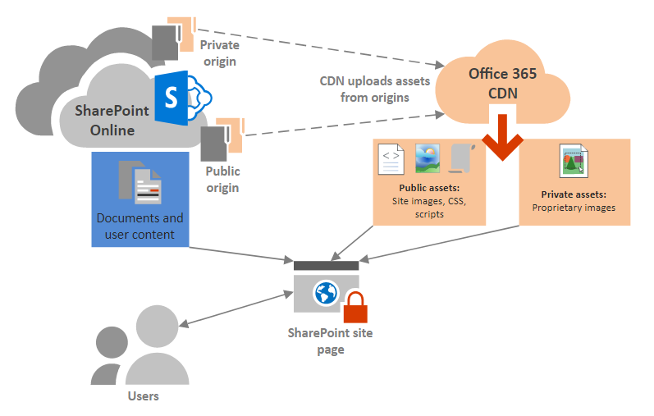
Host your client-side web part
There are multiple different hosting options for your web part assets.
Office 365 / Microsoft 365 CDN
Tenant Level appcatalog
Site Collection Level appcatalog
Azure CDN
SharePoint library CDN

Slide 4
Choose whether each origin should be public or private
When you identify an origin, you specify whether it should be made public or private. Access to CDN assets in public origins is anonymous, and CDN content in private origins is secured by dynamically generated tokens for greater security. Regardless of which option you choose, Microsoft does all the heavy lifting for you when it comes to administration of the CDN itself. Also, you can change your mind later, after you've set up the CDN and identified your origins.
Public origins within the Office 365 CDN are accessible anonymously, and hosted assets can be accessed by anyone who has the URL to the asset. Because access to content in public origins is anonymous, you should only use them to cache non-sensitive generic content such as javascript files, scripts, icons and images.
Private origins within the Office 365 CDN provide private access to user content such as SharePoint Online document libraries, sites and proprietary images. Access to content in private origins is secured by dynamically generated tokens so it can only be accessed by users with permissions to the original document library or storage location. Private origins in the Office 365 CDN can only be used for SharePoint Online content, and you can only access assets in private origins through redirection from your SharePoint Online tenant.

Slide 5
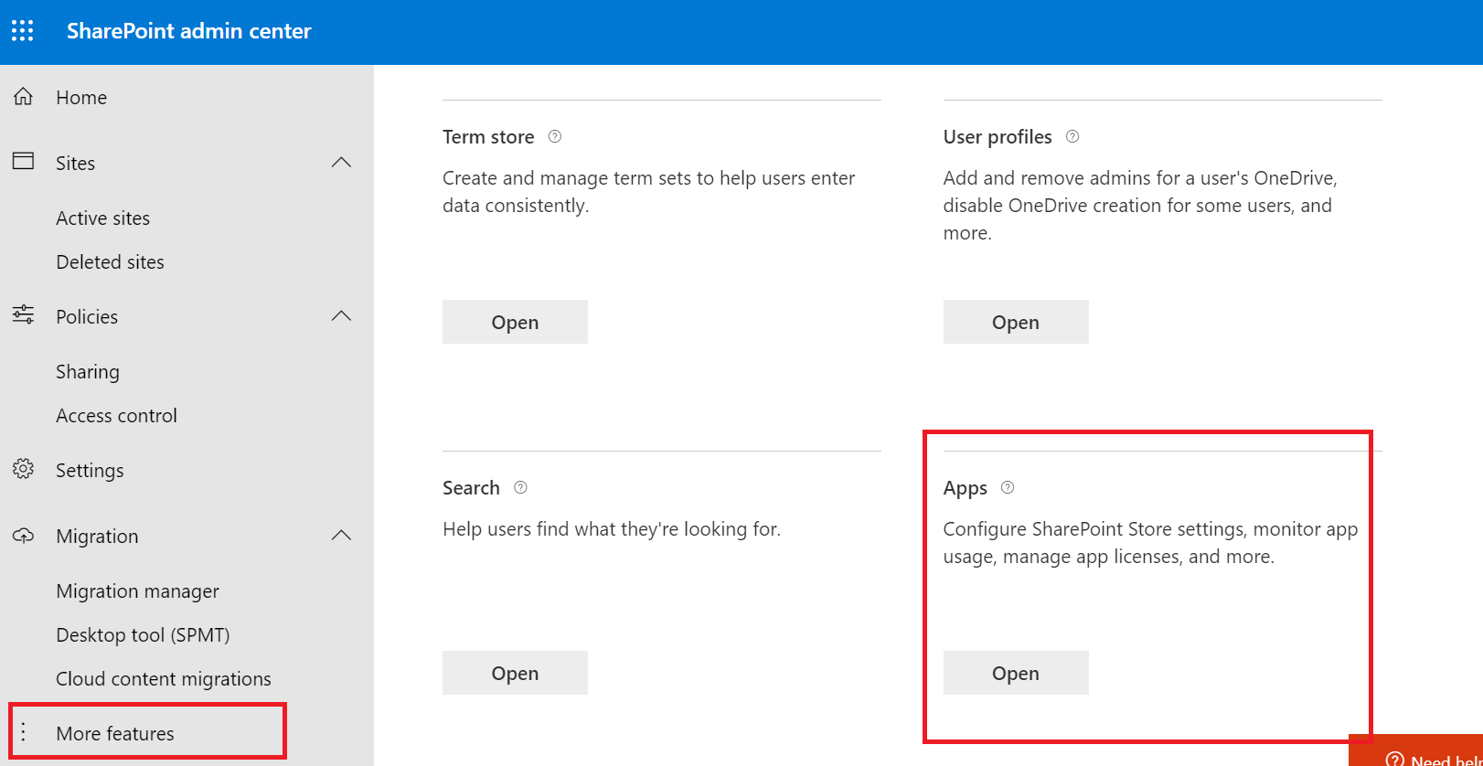
Create App Catalog Site
https://[tenant]-admin.sharepoint.com
SharePoint Framework solutions are deployed to an app catalog when they are ready for distribution

Slide 6
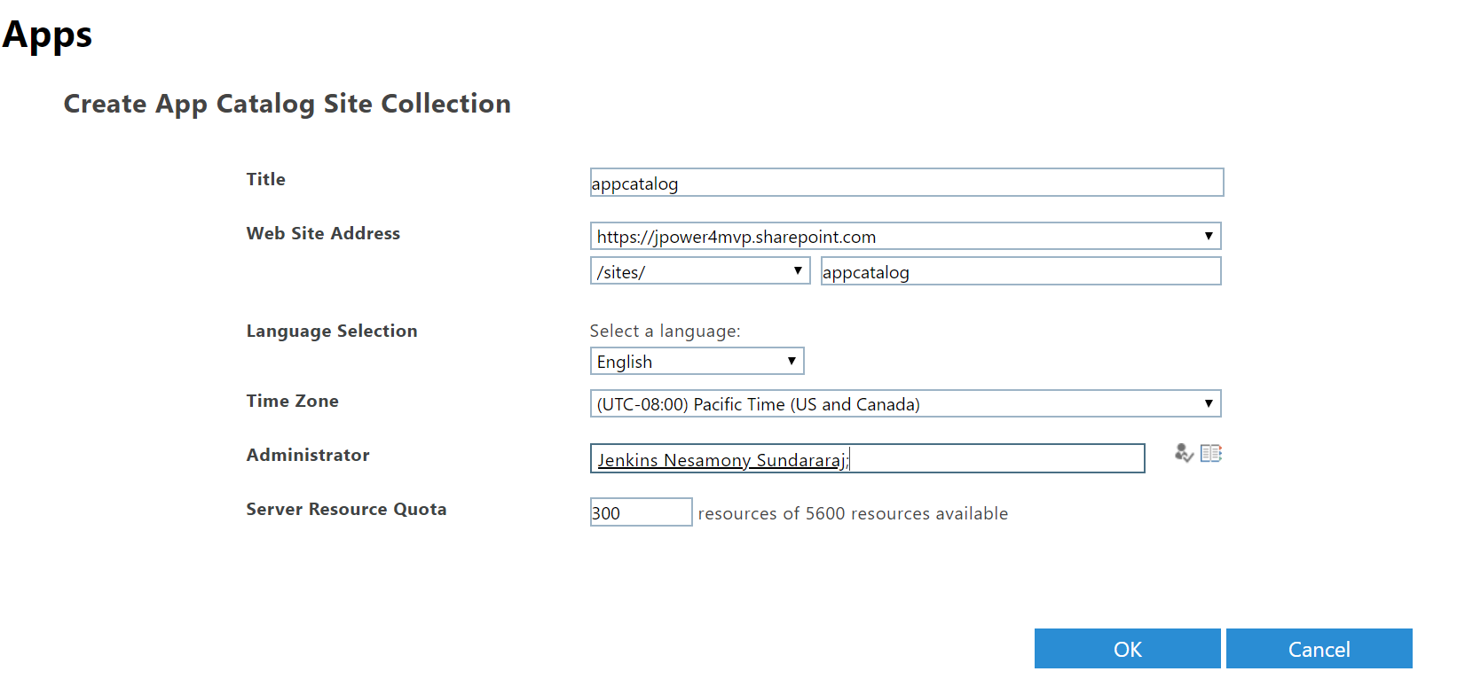
Create App Catalog Site

Slide 7
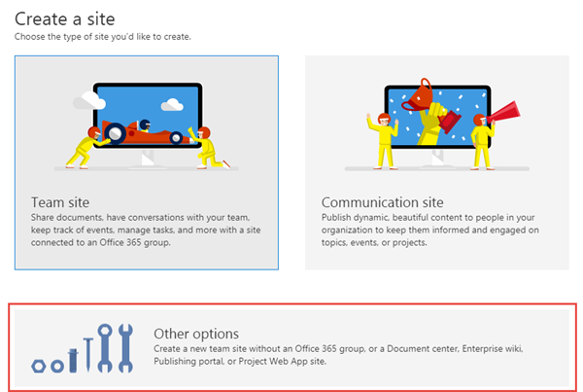
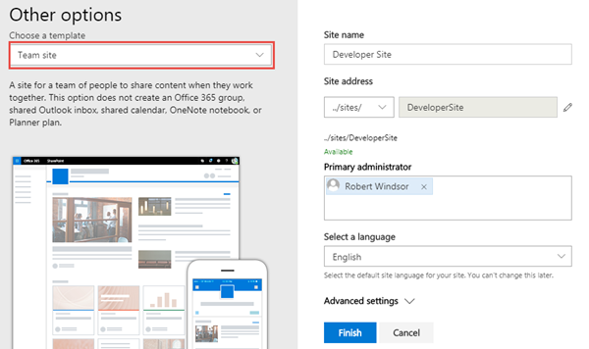
Create a new Development Site collection
https://[tenant]-admin.sharepoint.com
Use this site collection to test web parts and extensions

Slide 8
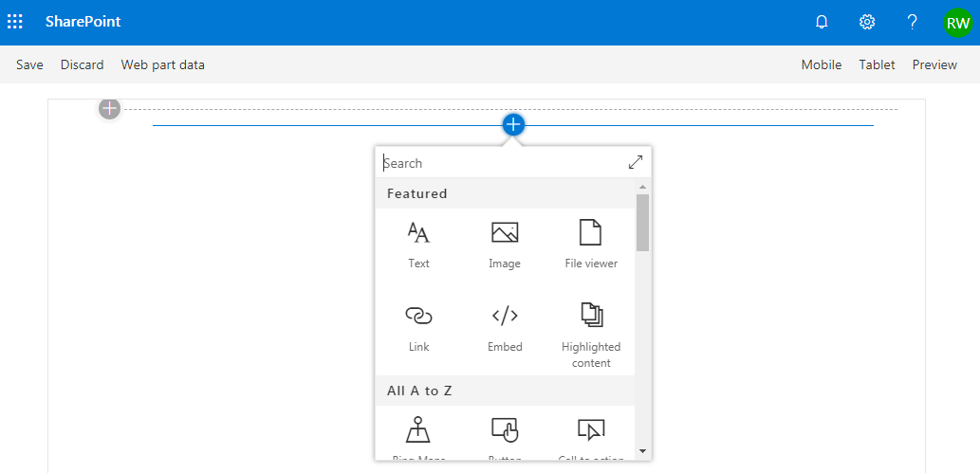
SharePoint Online Hosted Workbench
https://[sharpeointonline-site]/_layouts/workbench.aspx
SharePoint Online workbench can be accessed under any site with _layouts URL. Hosted site provides you site context where solution is executed.

Slide 9
Microsoft 365 CDN
You can use the built-in Microsoft 365 Content Delivery Network (CDN) to host static assets to provide better performance for your SharePoint Online pages. The Microsoft 365 CDN improves performance by caching static assets closer to the browsers requesting them, which helps to speed up downloads and reduce latency. Also, the Microsoft 365 CDN uses the HTTP/2 protocol for improved compression and HTTP pipelining. The Microsoft 365 CDN service is included as part of your SharePoint Online subscription.
Get the Microsoft 365 CDN status
Connect-SPOService -Url https://contoso-admin.sharepoint.com
Get-SPOTenantCdnEnabled -CdnType Public
Get-SPOTenantCdnOrigins -CdnType Public
Get-SPOTenantCdnPolicies -CdnType Public
https://docs.microsoft.com/en-us/powershell/module/sharepoint-online
https://www.microsoft.com/en-in/download/details.aspx?id=35588

Slide 10
Enable the Microsoft 365 CDN
Once you are connected to your Microsoft 365 tenant, use the following command to enable the Microsoft 365 CDN on your tenant:
Set-SPOTenantCdnEnabled -CdnType Public

Slide 11
Host your client-side web part from Microsoft 365 CDN
"includeClientSideAssets": true - The default value for the includeClientSideAssets is true, which means that static assets are packaged automatically in the *.sppkg files, and you don't need to separately host your assets from an external system.
gulp clean
gulp build
gulp bundle --ship
gulp deploy-azure-storage (only for Azure CDN)
gulp package-solution --ship
package on the SharePoint/solution folder.

Slide 12
Enable Public CDN
Office 365 Content Delivery Network (CDN)
Microsoft introduced Office 365 CDN capability, which is used to host your assets directly from your Office 365 Tenant and it can be accessed by SharePoint sites and add-ins with the help of CDN URLs.
Prerequisites to enable Public CDN
Download SharePoint Online Management Shell
Steps involved to enable Public CDN
Open SharePoint Online Management Shell.
Run the command given below in the Management Shell to connect to your SharePoint Online Tenant
Connect-SPOService -Url https://Jpower4mvp-admin.sharepoint.com
Run the command given below to enable CDN in your Tenant.
Set-SPOTenantCdnEnabled -CdnType Public
Create SPSite and Create a new document library in one of your SharePoint Online sites within your Tenant. I have created a folder , which will be added as new CDN origin.
Run the command given below to add a new CDN origin.
Add-SPOTenantCdnOrigin -CdnType Public -OriginUrl sites/JPOWER4/cdn
Run the command given below to get all public Tenant CDN origins.
Get-SPOTenantCdnOrigins -CdnType Public
Assets hosted in public CDN origins can be accessed by public CDN URL.
https://publiccdn.sharepointonline.com/<tenant host name>/sites/site/library

Slide 13
Add a new CDN origin
In this case, we are setting the origin as */cdn, which means that any relative folder with the name of cdn acts as a CDN origin.
Add-SPOTenantCdnOrigin -CdnType Public -OriginUrl */cdn

Slide 14
Default CDN origins
Unless you specify otherwise, Office 365 sets up some default origins for you when you enable the Office 365 CDN. If you initially opt not to provision them, you can add these origins after you complete setup. Unless you understand the consequences of skipping the setup of default origins and have a specific reason for doing so, you should allow them to be created when you enable the CDN.
Default private CDN origins:
*/userphoto.aspx
*/siteassets
Default public CDN origins:
*/masterpage
*/style library
*/clientsideassets

Slide 15
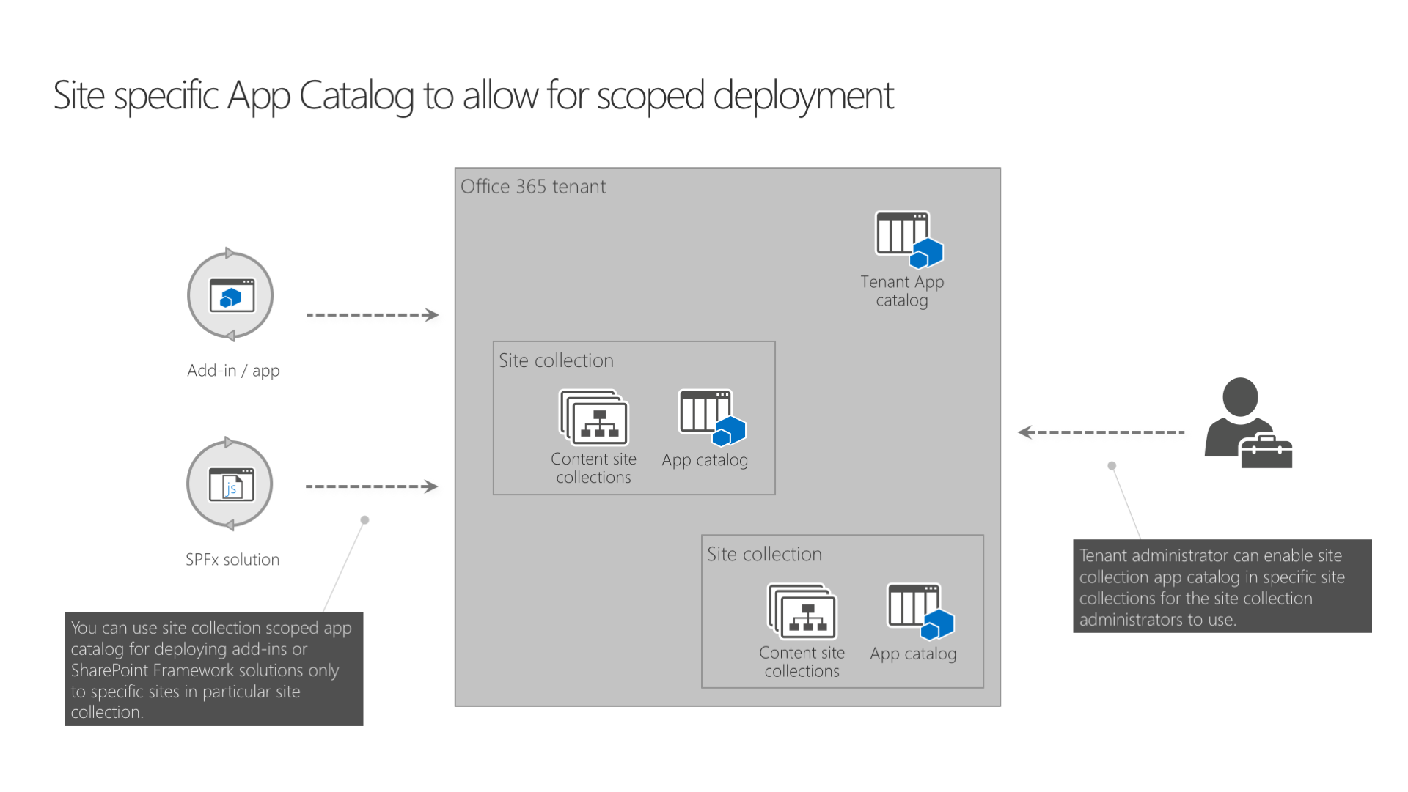
Use the site collection app catalog
Using site collection app catalogs, SharePoint tenant administrators can decentralize the management and scope the deployment of SharePoint add-ins and SharePoint Framework solutions to specific sites.
With the introduction of site collection app catalogs, tenant administrators can enable app catalog on the specific sites. Once enabled, site collection administrators can deploy SharePoint add-ins and SharePoint Framework solutions that will be available only in that particular site collection

Slide 16
Create & Disable a site collection app catalog
Connect-SPOService -Url https://contoso-admin.sharepoint.com
Add-SPOSiteCollectionAppCatalog -Site https://contoso.sharepoint.com/sites/marketing
Remove-SPOSiteCollectionAppCatalog -Site https://contoso.sharepoint.com/sites/marketing
To list all site collections in the tenant that have the site collection app catalog enabled, use the URL https://<tenant-app-catalog-URL>/Lists/SiteCollectionAppCatalogs/AllItems.aspx

Slide 17
Azure CDN
Create a new sample web part and deploy its assets to an Azure Content Delivery Network (CDN) instead of using the default Office 365 CDN as the hosting solution. You'll use an Azure Storage account integrated with a CDN to deploy your assets. SharePoint Framework build tools provide out-of-the-box support for deploying to an Azure Storage account; however, you can also manually upload the files to your favorite CDN provider or to SharePoint.
https://docs.microsoft.com/en-us/sharepoint/dev/spfx/web-parts/get-started/deploy-web-part-to-cdn

Slide 18
Manual steps for shipping your solutions
Clean your solution
gulp clean
gulp build
Bundle your solution
gulp bundle --ship
Package your solution
gulp package-solution --ship
Upload the solution package and deploy it in the app catalog (site or tenant)

Slide 19
What is DevOps?
DevOps is set of practices that combines Software Development (Dev) and IT operations (Ops) which can result into shorter development life cycle and provides continuous delivery by releasing software faster, frequently and efficiently with improved quality.

Slide 20
What is Azure DevOps
Azure DevOps is one of the offering from Microsoft Cloud services portfolio which is fully integrated services that provides us tools for building, maintaining, hosting source code and more importantly putting everything together for continuous integrations and deployment. Azure Dev Ops comes with sub services including Boards, Repos, Pipelines, Test Plans, Artifacts.
Azure Pipelines are at the core of Azure DevOps which puts all the pieces together. Azure pipeline is a service which we can used to automate builds and test our projects with any programming language or project type. Azure pipelines are targeted to build and release part of your project. The build part is taken care by creating a Pipeline for continuous integration (CI) and the Release is for continuous deployment. A recent feature multi-stage pipelines allows us to split the deployment into multiple stages for reusability. Multi-stage pipelines uses YAML format to define this pipeline, allowing deployment instructions to live alongside the source code.

Slide 21
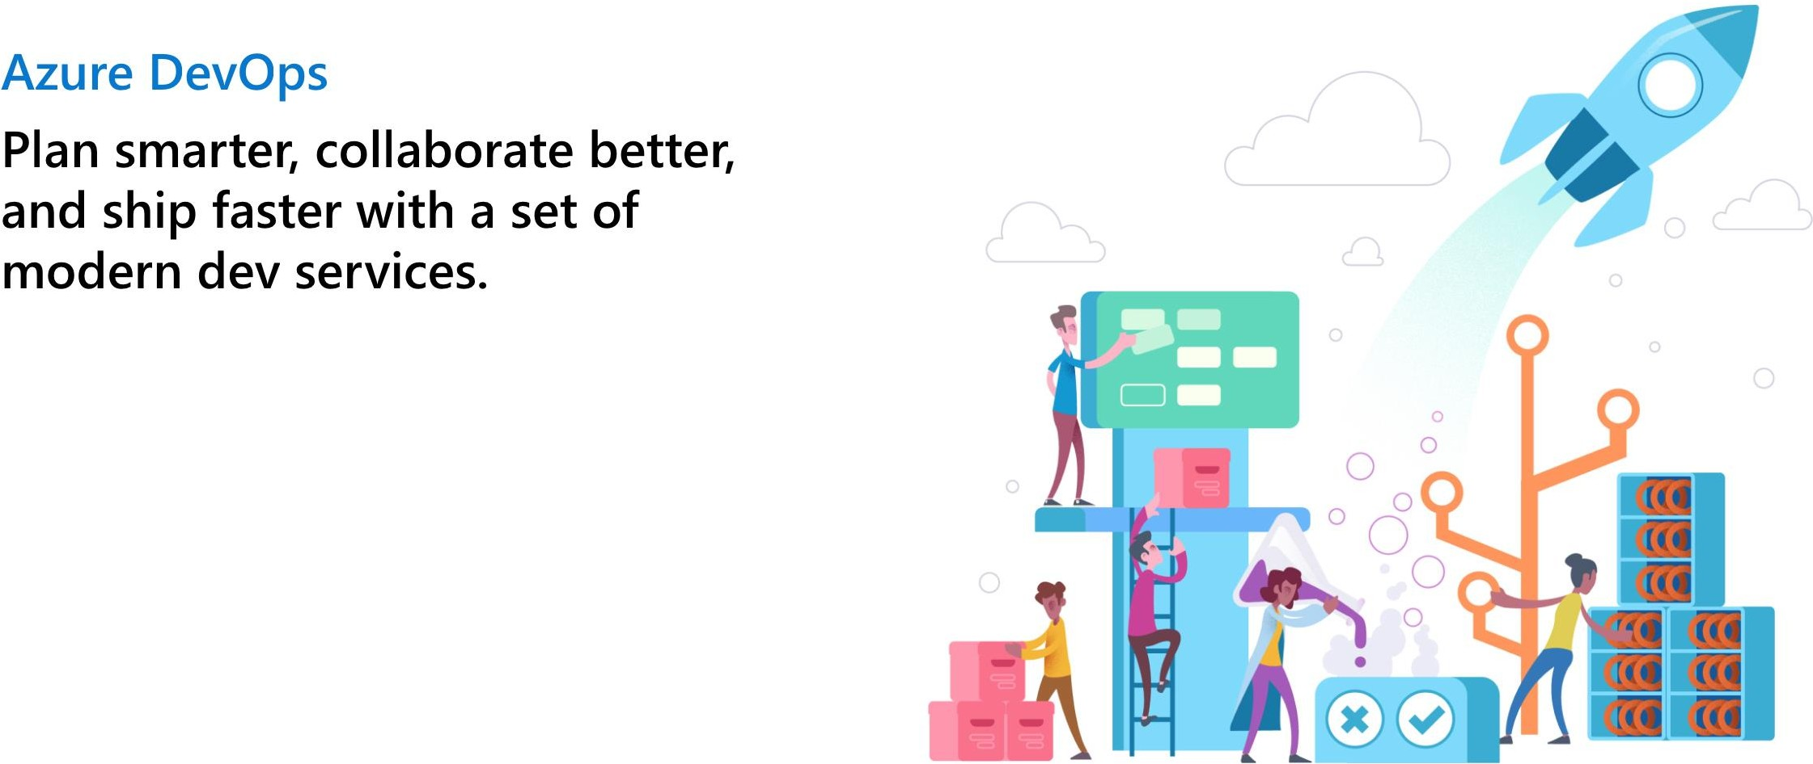

Slide 22
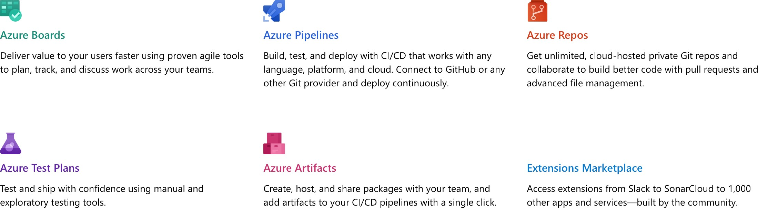

Slide 23




Slide 24
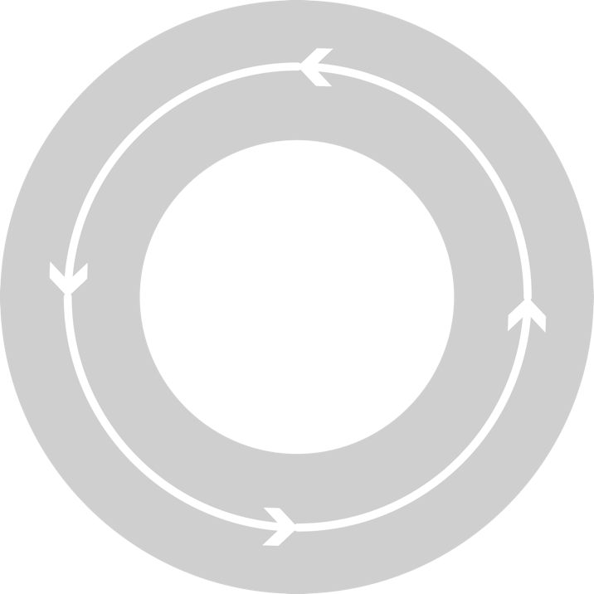



₄ Monitor + Learn
DevOps process
₁ Plan
Development
Production
₂ Develop + Test
₃ Release

Slide 25
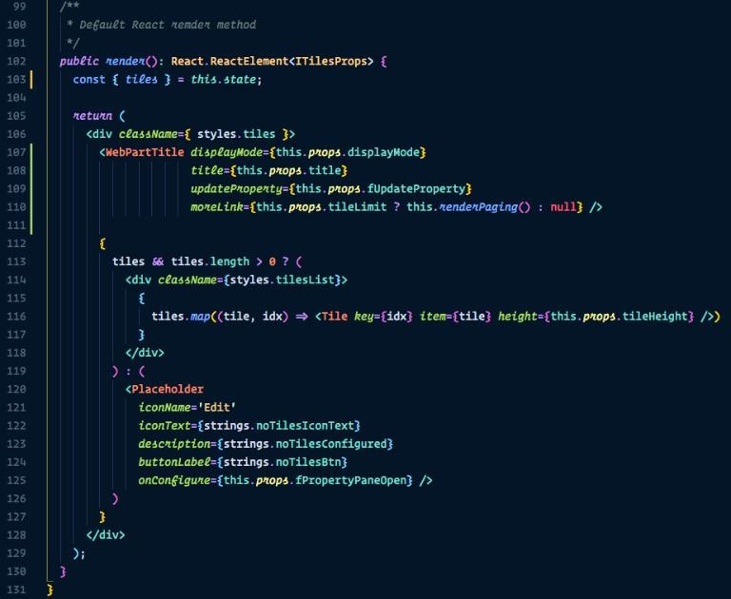


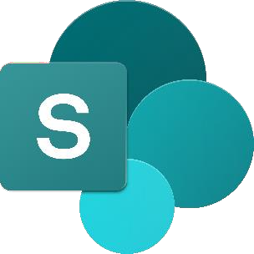


What is the process to get it automated?
CI CD

Slide 26
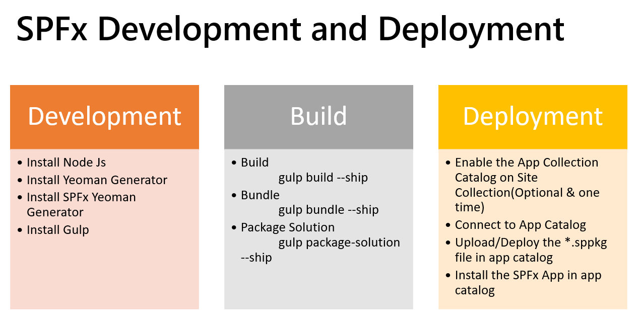
SharePoint Framework Development and Deployment Process
SPFx is new client-side development framework for customizing SharePoint. We will just touch base on few aspects of SPFx which is required to know for purpose of article.
SPFx is developed using NodeJS.
We use different npm packages which can be used in SPFx solution.
Gulp is used to build, bundle and package SPFx solution.
We get *.sppkg file which can be used to deploy to app catalog.
Deployed app can be installed on one or more site collection.

Slide 27
What we will be doing by Implementing CI/CD?
Automate SPFx package build part using CI (build pipeline)
Automate deployment of package (CD) to deploy to app catalog and install to target site collections.

Slide 28
Azure DevOps CI CD for SPFx Demo

Slide 29
Demo
Tenant Level appcatalog
Site Collection level appcatalog
Office 365 CDN setup
Azure CDN setup
Other options

Slide 30
References
https://pnp.github.io/pnpjs/sp/

